Slide 1
CAPSTONE PROJECT : BATTLE OF THE NEIGHBOURHOODS
IDENTIFYING BEST NEIGHBORHOOD TO START A NEW RESTAUARNT

Slide 2
INTRODUCTION
The economic recession that put America on its knees hardly touched Toronto. Steadied by strong, highly regulated banks and buoyed by an educated workforce, Canada's largest city is open for business.
Toronto regularly tops most livable cities lists, in part because it has a large percentage of parkland. The immigrant population is so large that the city has several Chinatowns and Little Italys, in addition to dozens of ethnic neighborhoods.
The idea of the project is to help the stake holders by identifying the appropriate location to start his/her new restaurant. From the above points identifying the no. of neighborhoods , population and income plays an important role in establishing a new restaurant

Slide 3
DATA DESCRIPTION
The neighbourhood profiles were developed to help government and community agencies with their local planning, by providing socio-economic data at a meaningful geographic area.
The list of neighbourhoods, and the demographic data associated to each neighbourhood, has been made available by the city of Toronto here :
https://www.toronto.ca/ext/open_data/catalog/data_set_files/2016_neighbourhood_profiles.csv
We query FoursquareAPI suplying the neighbourhood's information (coordinates calculated with the Geocoder package), the radius of scan, and the limit of number of venues we want to retrieve.

Slide 4
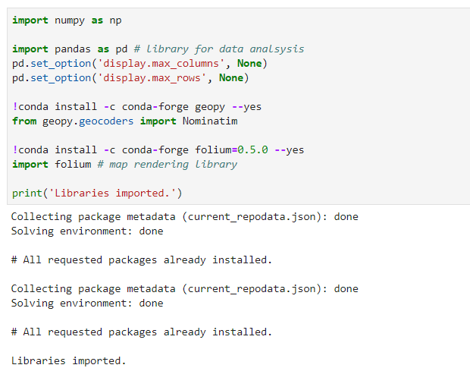
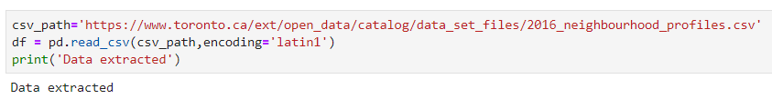
Methodology
All the necessary packages required are loaded as shown below.
We extract the data from the path given as shown below

Slide 5
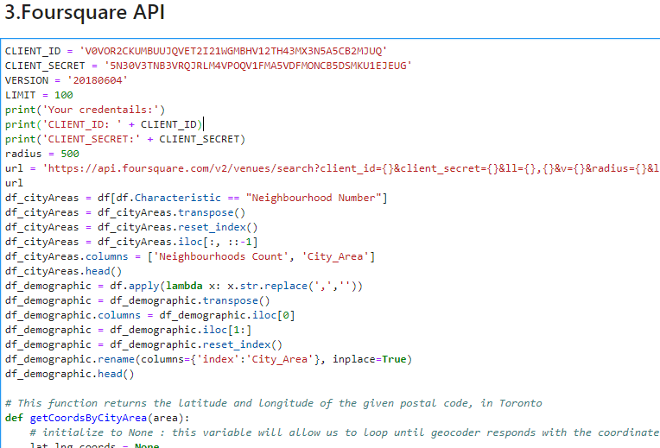
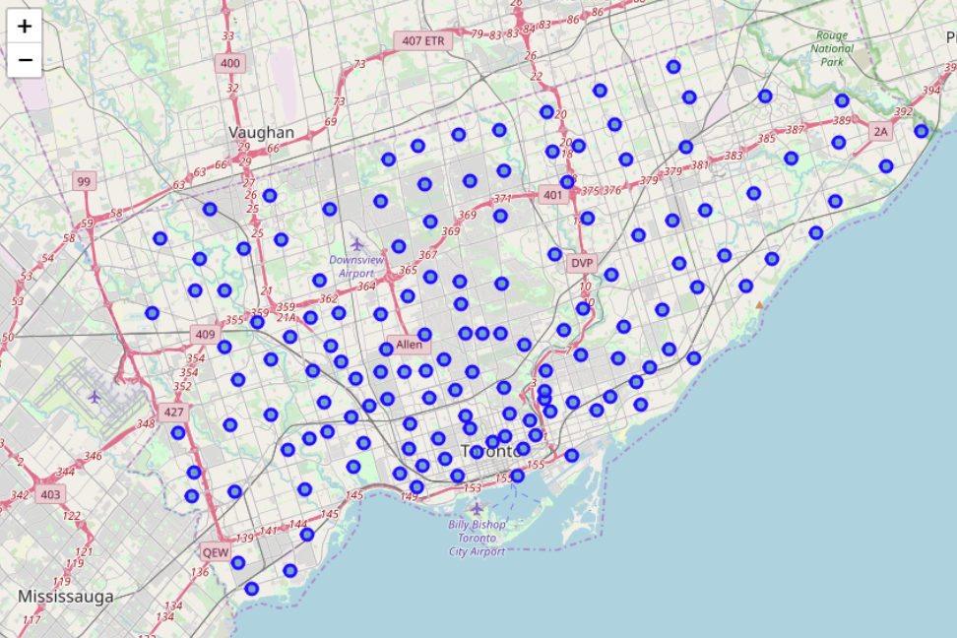
Using Foursquare API we the neighbor hoods and the same is done , some part of the code is shown below and the neighborhoods are shown in the map

Slide 6
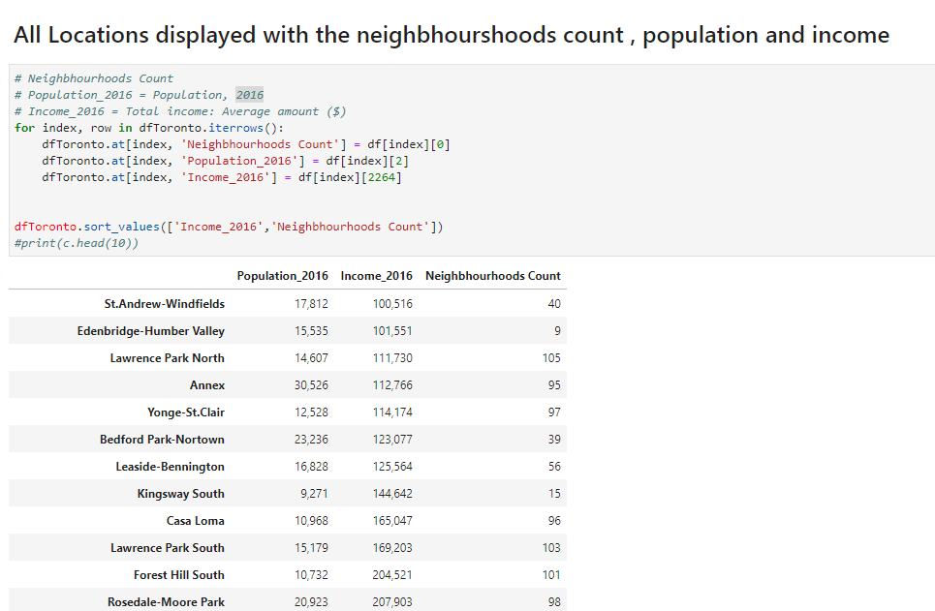
The neighborhoods are now displayed with their income and population in the sorting order of income and then neighborhood count

Slide 7
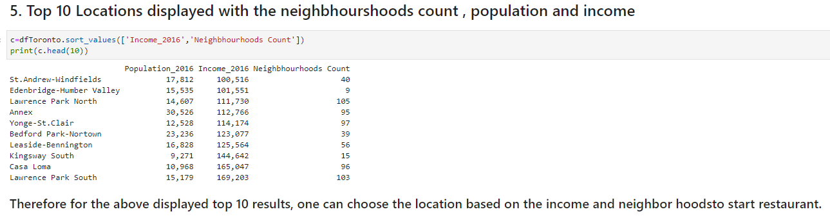
The top 10 neighborhoods are shown below based on the income and followed y neighborhoods count

Slide 8
Conclusion
In this project, the neighborhoods are identified based on their population and income. This gives the insight of various neighborhoods for the opening of a new restaurant.
Then, the 10 neighborhoods are populated with the adequate information such as income and the count, within these adequate neighborhoods, one can gain profits if a restaurant is opened.
Catering services can use similar data analysis in order to find the best spots to open a retail shop.

